Slide 1



Botnet Attack Detection at the IoT Edge Based on Sparse Representation
Christos Tzagkarakis
FORTH-ICS

Slide 2








Introduction
Internet-of-Things (IoT) has advanced the concept of Internet networking
Smart home
Backend/Cloud
Smart cities
Network
Wearables
Predictive maintenance
Field/Edge
Automotive driving

Slide 3


Introduction
Rapidly growing use and realization of IoT-based technology comes at the cost of resolving business and technical impediments
Rapidly growing use and realization of IoT-based technology comes at the cost of resolving business and technical impediments
Dynamicity
Scalability
Heterogeneity
End-to-end security/privacy
Focus: efficient, robust and fast detection of botnet attacks at the IoT edge level

Slide 4

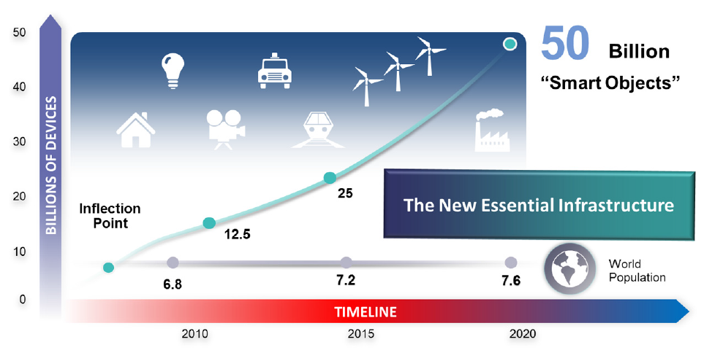

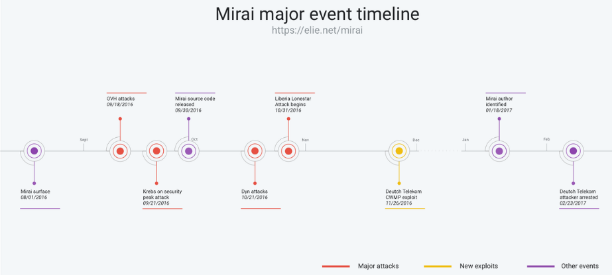

Motivation & Background
IoT usage: exponential growth
Autonomous physical/digital objects augmented with sensing, processing and network capabilities
Vermesan and Friess (2014)
Security aspects of IoT devices are often neglected leading to exponential risk
2016 Mirai IoT botnet attack at the US east coast

Slide 5



Motivation & Background
IoT-related detection methods focus on early steps of propagation and communication with the C&C server
Network monitoring for early infection identification is not often
sufficient
Develop diagnosis mechanisms when IoT bots begin launching attacks
Instant detection of IoT botnet attacks
and isolation of compromised IoT devices
Last line of defense security layer
IoT edge devices typically have limited
power, processing, memory capabilities
Employ fast detection on power constrained IoT devices based on small amount of IoT network traffic data to detect compromised IoT devices
IoT gateway might also have similar
technical constraints

Slide 6

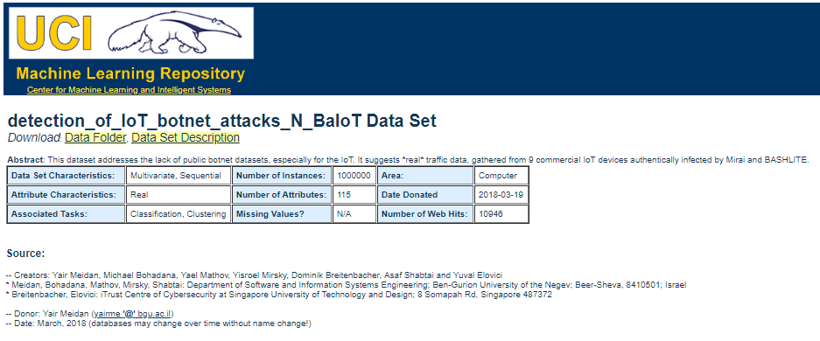
IoT network traffic data
Meidan, et.al, “N-BaIoT: Network based detection of IoT Botnet attacks using
deep autoencoders,” In IEEE Pervasive Computing, vol.13, no.9, July-September 2018
N-BaIoT dataset
Number of benign instances in online dataset
40395
34692
13111
160137
55169
91555
42784
--
46817
Meidan, et.al, “N-BaIoT: Network based detection of IoT Botnet attacks using deep autoencoders,”

Slide 7

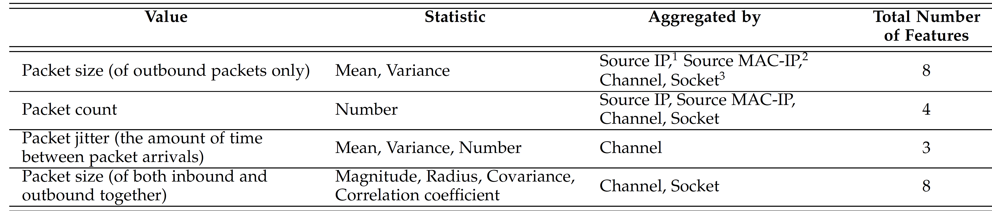
IoT network traffic data
Data pre-processing: feature extraction
  Whenever a packets arrives, obtain a behavioral snapshot of the hosts and protocols that communicated the packet
  Extract 23 temporal traffic statistics (features/instances) over a temporal window, summarizing the traffic that:
Meidan, et.al, “N-BaIoT: Network based detection of IoT Botnet attacks using deep autoencoders,”
Originated form the same IP
Originated form both the same source MAC and the same IP address
Sent between the source and destination IPs
Sent between the source and the destination TCP/UDP sockets
100 ms
23 features
500 ms
23 features
115-dimensional feature instance corresponding to five temporal windows
1.5 sec
23 features
10 sec
23 features
60 sec
23 features

Slide 8







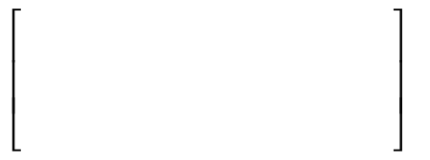














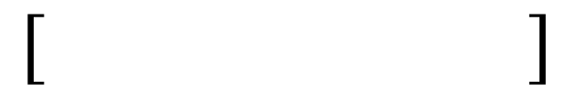

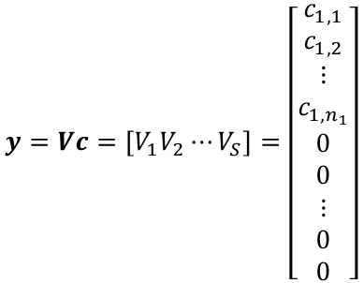







Proposed IoT botnet attack detection method
Assume $S$ IoT devices in general
115-dimension
115-dimension
$$⋯$$
115-dimension
#n₁ instances of traffic data
#n₂ instances of traffic data
#n_{S} instances of traffic data
$$⋯$$
$$=$$
$c_{1,1}∙$
$$+$$
$c_{1,2}∙$
$$+⋯+$$
${ c}_{1,n_{1}}∙$
$$V_{1}$$
$$V_{S}$$
$$V_{1}$$
$$V_{2}$$
$$V_{2}$$
$c_{1,1}v_{1,1}$
$$c_{1,2}v_{1,2}$$
$$+⋯+$$
$$c_{1,n_{1}}v_{1,n_{1}}$$
$$y=Vc=\left[V_{1}V_{2}⋯V_{S}\right]=\left[\begin{aligned}c_{1,1} \\ c_{1,2} \\ ⋮ \\ c_{1,n_{1}} \\ 0 \\ 0 \\ ⋮ \\ 0 \\ 0\end{aligned}\right]$$
$$y=$$
$$+$$
$$= V_{1}c_{1}$$
Instances corresponding to benign traffic behaviour
$$⋯$$
$$∙c$$
sparse code
IoT device 1

Slide 9

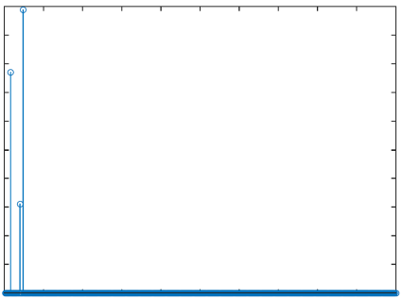
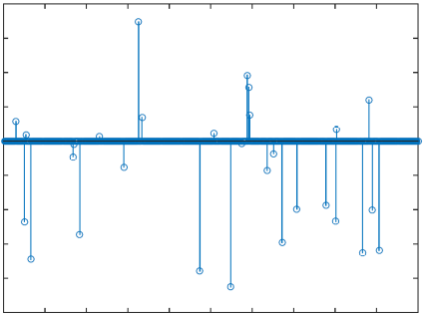

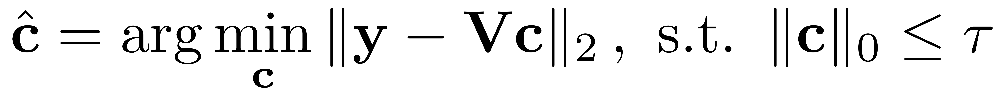
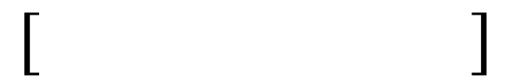



Proposed IoT botnet attack detection method
Toy example: ideal sparse code corresponding to a benign instance
Toy example: ideal sparse code corresponding to a
malicious instance
Time-Delay Embedding
Overall benign data matrix $V$
$$⋯$$
Observed instance $y$
Use the concept of reconstruction error to detect abnormality of the sparse codes
Lightweight algorithm
Orthogonal matching pursuit
sparsity threshold

Slide 10
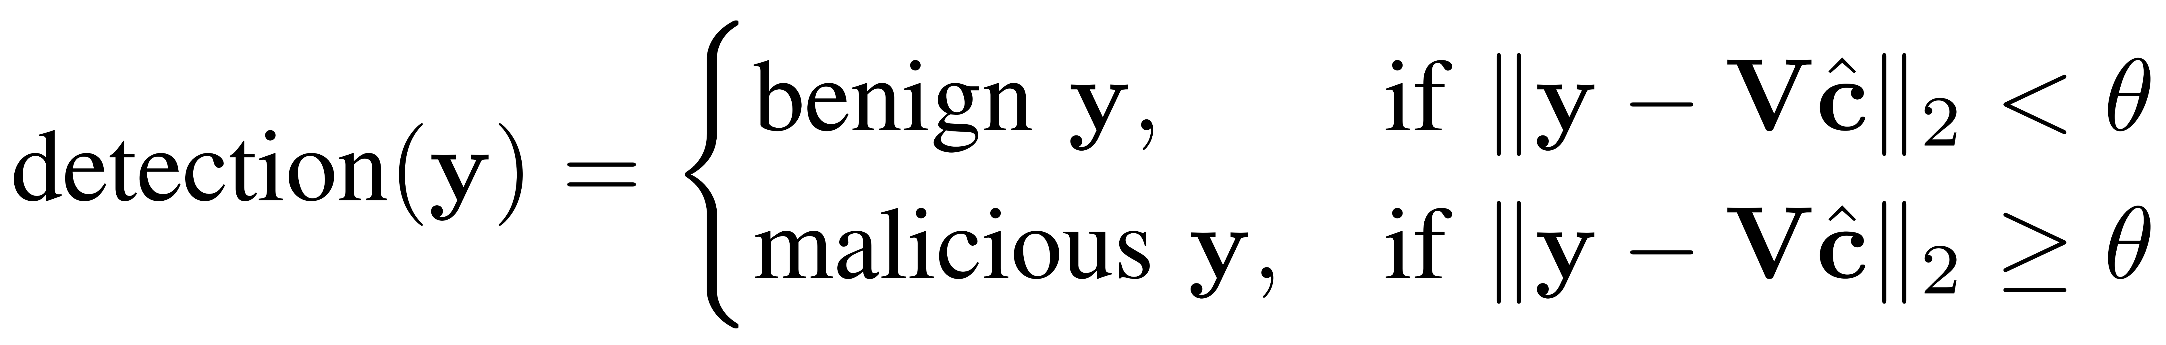
Decision threshold estimation
Critical hyper-parameter tuning: decision threshold $θ$
Fundamental assumption: we use only benign
IoT traffic data (no malicious training data)
We use proxy outliers: based on the computed sparse codes reconstruction errors

Slide 11
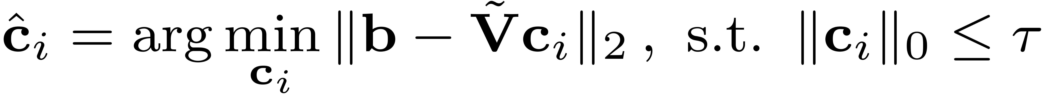
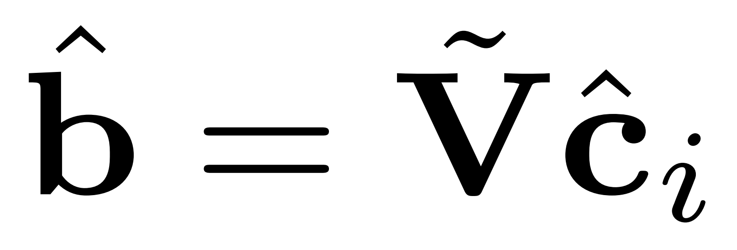
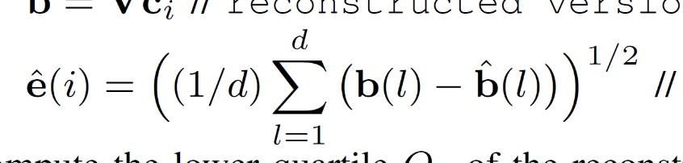

Decision threshold estimation
Critical hyper-parameter tuning: decision threshold $θ$
Fundamental assumption: we use only benign
IoT traffic data (no malicious training data)
We use proxy outliers: based on the computed sparse codes reconstruction errors
$$\tilde{V}$$
matrix V with all
benign “training” instances
Reconstructed version
RMSE error

Slide 12
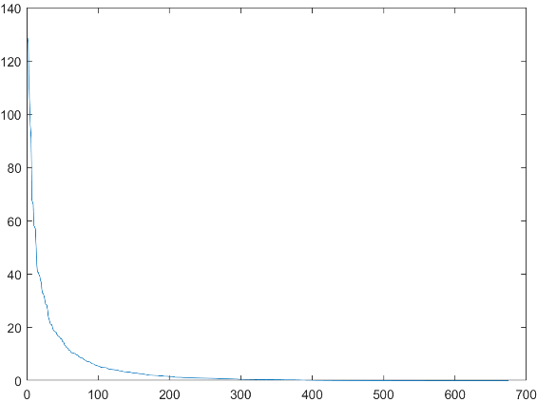
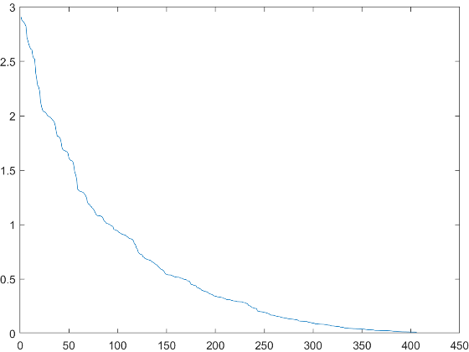



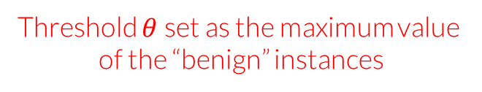
Decision threshold estimation
Threshold $θ$set as the maximum value
of the “benign” instances
Estimated RMS errors e
Compute the lower quartile Q₁
Compute the upper quartile Q₃
Compute the inter-quartile range IQR= Q₃-Q₁
Hyper-parameter tuning
The i-th instance is considered as an outlier (proxy) if
All benign training data
$$V$$
Proxy outliers estimation
Rejection rate: percentage of instances that are within the non-extreme limits
$$V_{n}$$
$$V_{m}$$
Benign training data
Malicious training data

Slide 13

Majority voting scheme
Solve the sparse optimization problem for each temporal window separately and use majority voting rule for the final decision
Solve five sparse representation problems→ act like ensemble learning algorithms to face adverse problem conditions → short training/testing instances
solve sparse representation problem for each window separately
100 ms
window 1
23 instances
500 ms
window 2
23 instances
identify if each temporal window’s instance is malicious or benign
1.5 sec
window 3
23 instances
10 sec
window 4
23 instances
majority voting rule
for final decision
60 sec
window 5
23 instances

Slide 14

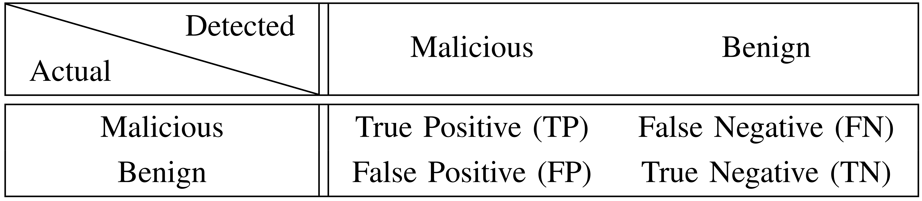
Test case: BASHLITE botnet attack
Examine BASHLITE botnet attack
  Scan: scanning the network for vulnerable devices
  Junk: sending spam data
  COMBO: sending spam data and opening a connection to a specified IP address port
  Positive predictive value (PPV)→ TP/(TP+FP)
  Sensitivity→ TP/(TP+FN)
  F1-score→ (2TP)/(2TP+FP+FN)
  Accuracy (ACC)→ ((TP+TN)/(TP+TN+FP+FN))

Slide 15
Test case: BASHLITE botnet attack
3-fold cross validation
Search space of sparsity level→ {5, 10, 15, 20, 30}
Search space of rejection rate→ {0.01, 0.5, 1, 2, 3}
Compare sparse representation (SR) vs. typical autoencoder (AE) with a single hidden layer
  Number of epochs→ 50
  Search space of number of nodes→ {20, 30, 40, 50, 60}
Leave-one-device-out cross validation (LOOCV)
  Benign instances from S-1 IoT devices are used for hyper-parameter tuning
  S-th IoT device’s benign instances coupled with malicious instances from all other IoT devices are used for performance evaluation
  LOOCV is repeated S times and the average performance is computed
100, 300, 500 benign instances per IoT device for cross validation
1600 total malicious instances from all IoT devices for testing

Slide 16
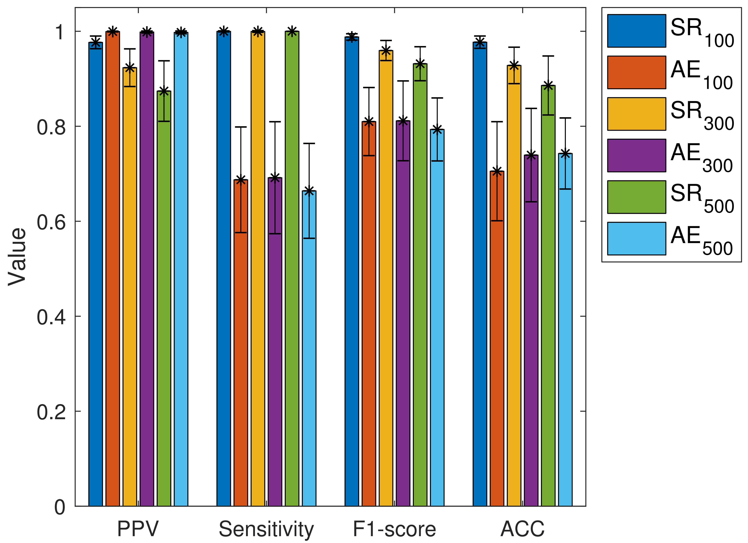
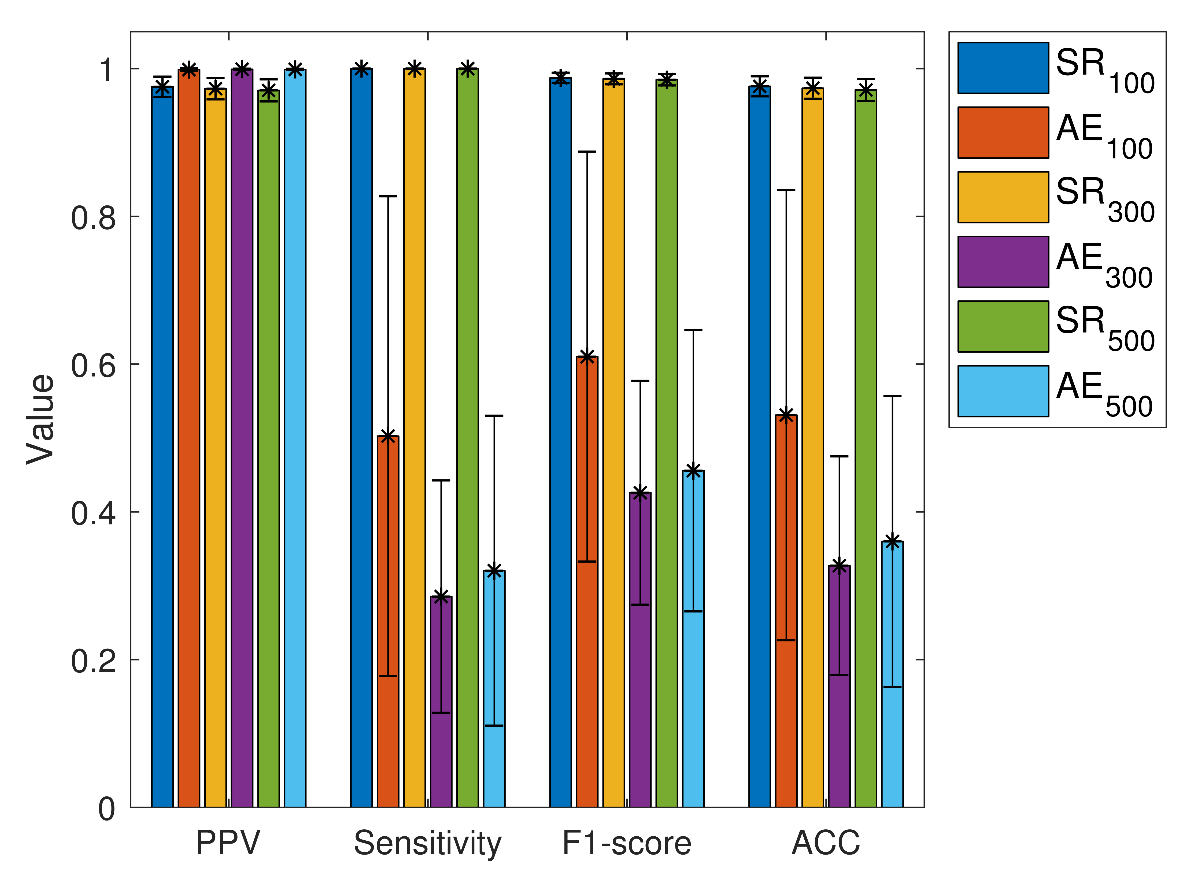
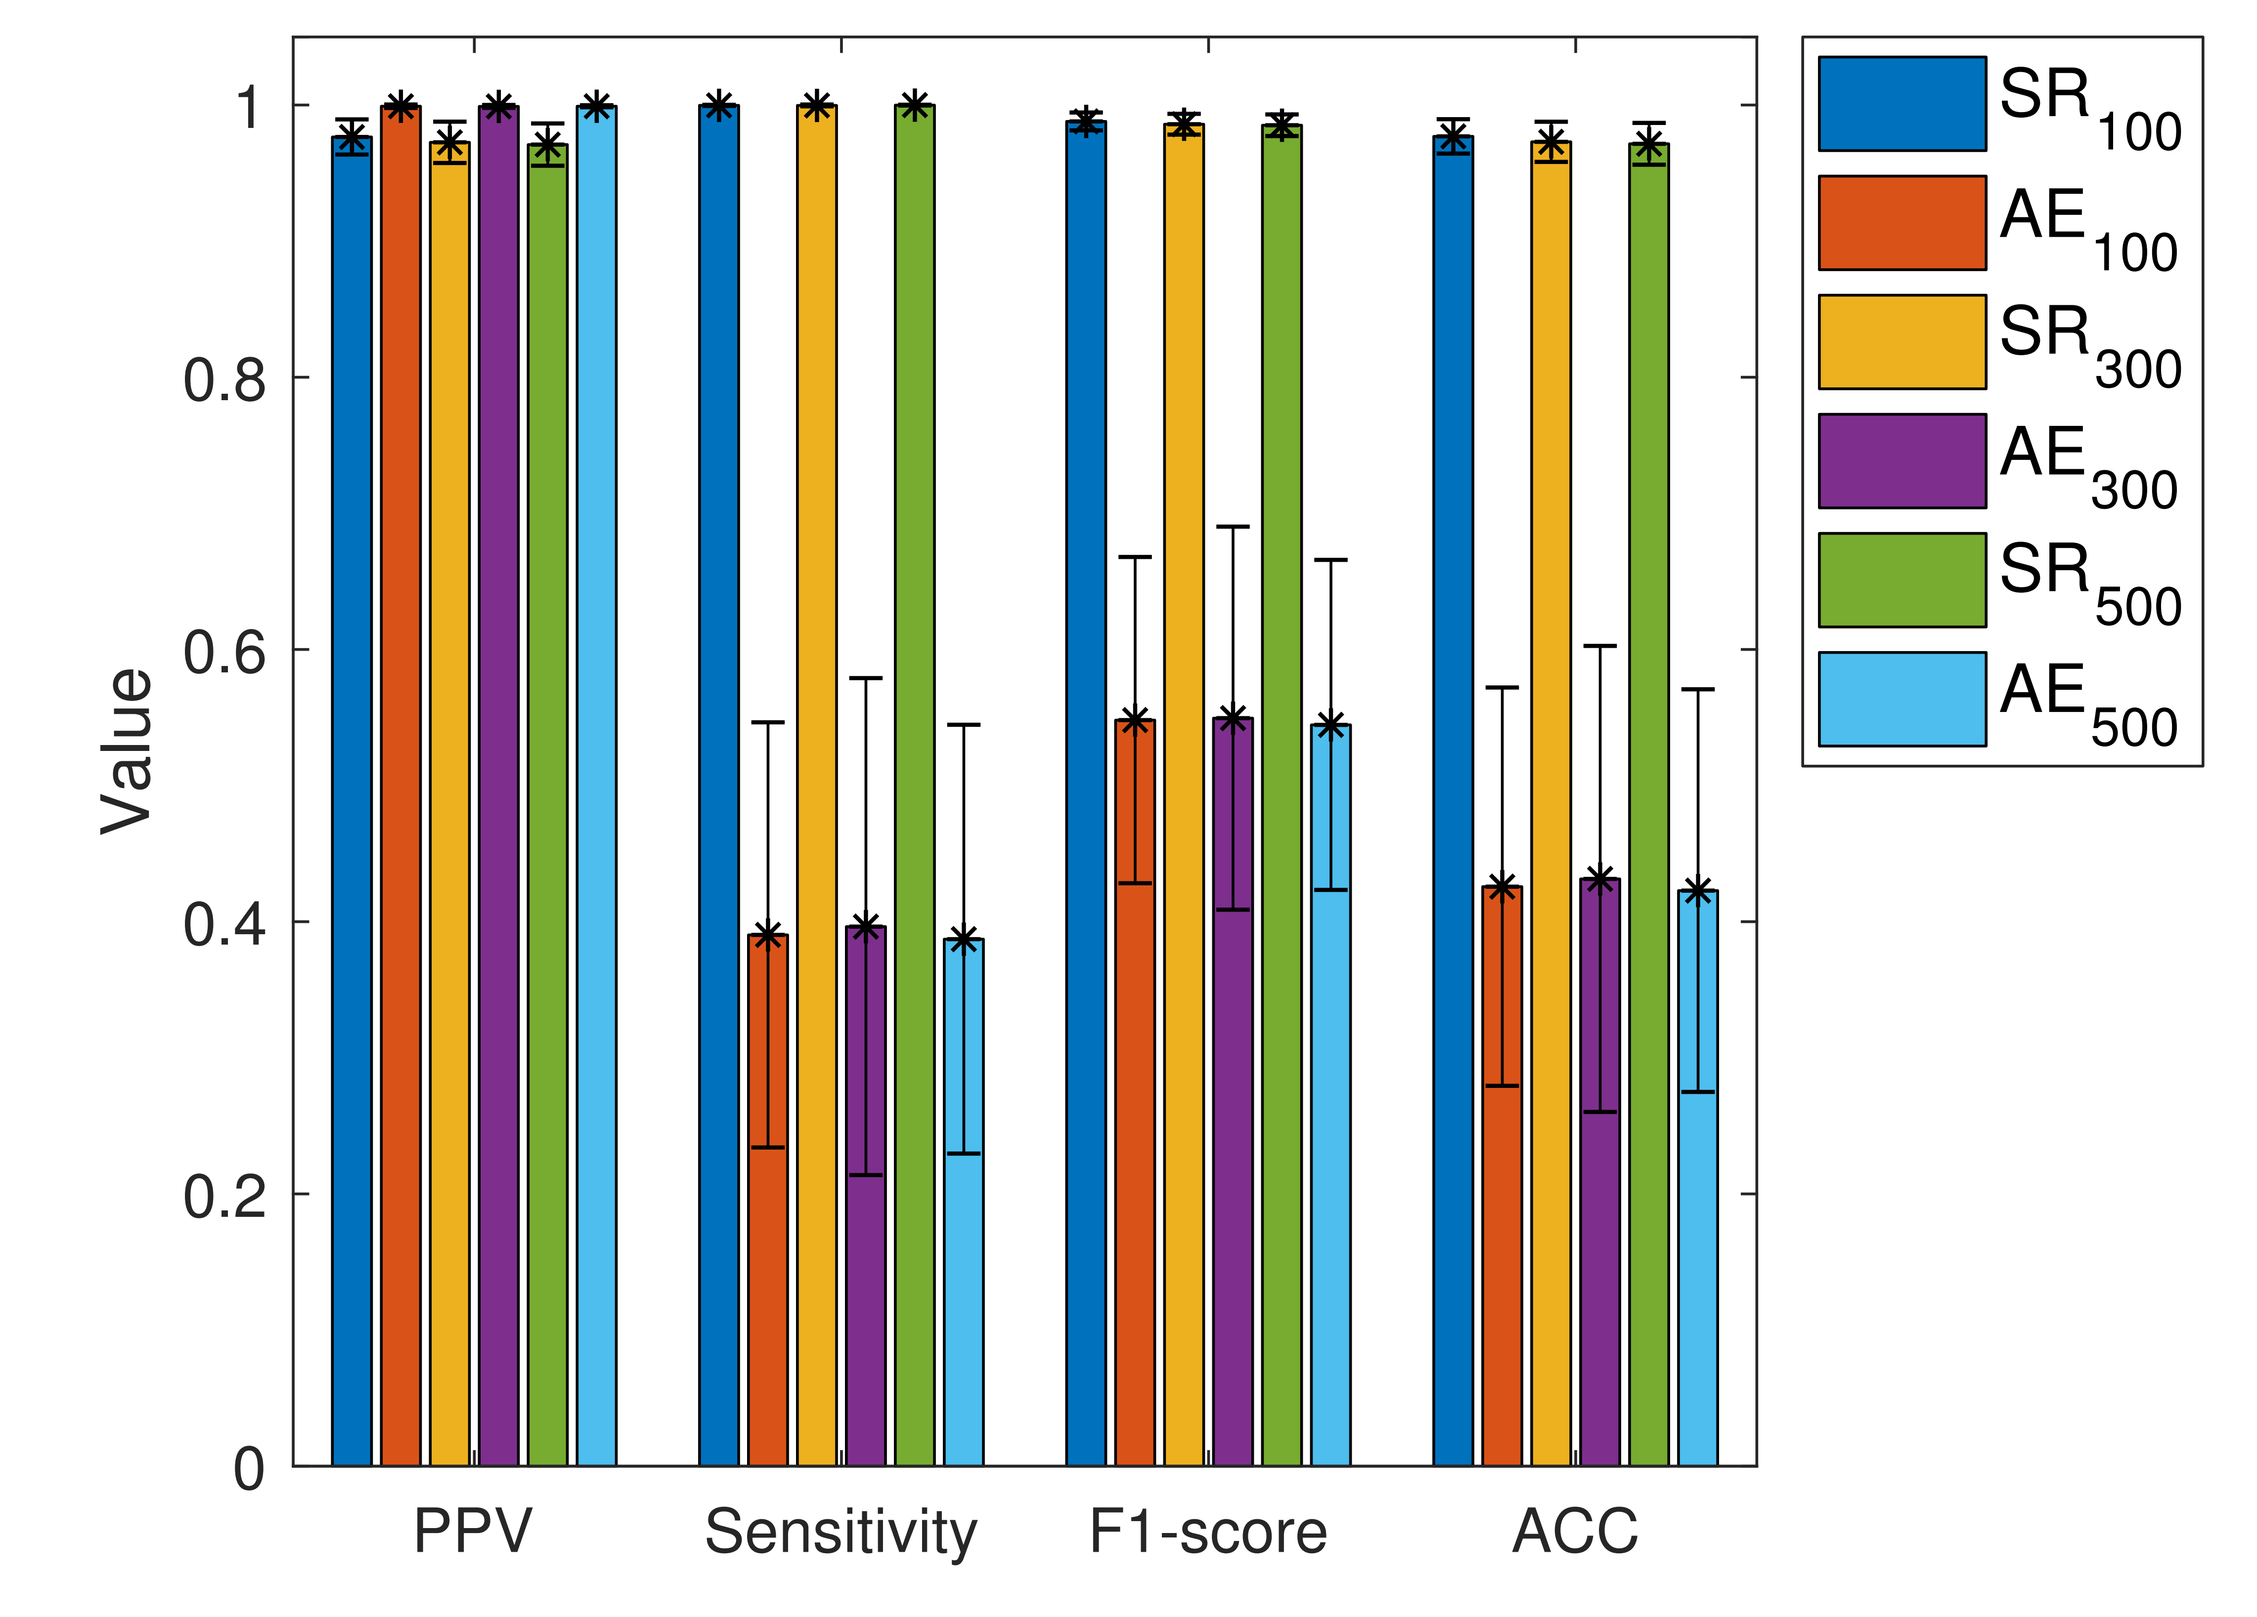
Test case: BASHLITE botnet attack
COMBO
Junk
Scan

Slide 17

Test case: BASHLITE botnet attack
SR achieves superior performance in light of Sensitivity, F1-score and ACC, while AE achieves slightly better results in terms of PPV. That means that SR is robust in accurately detecting both malicious and normal behaviour in the IoT network
The time complexity between SR and AE is comparable and low and thus SR can be applied for accurate and fast IoT botnet attack detection

Slide 18
Future directions
Examine the efficiency of the proposed approach on more IoT botnet attack datasets and scenarios
Perform thorough comparisons in terms of detection accuracy and time complexity with additional lightweight IoT botnet attack detection methods

Slide 19


