Slide 1


Christos Tzagkarakis
Department of Computer Science, University of Crete
ICS ― Foundation for Research & Technology-Hellas
Sparse and low-rank techniques for robust speaker recognition and missing-feature reconstruction
1 July 2014, Heraklion

Slide 2
Outline
Part I
Part II
Overview of speaker
identification (SID)
Overview of missing features recovery
Sparse representation classification (SRC) for SID
Low-rank missing data imputation
Statistical modeling using KL divergence
Experimental results – Part II.a
Joint low-rank representation and matrix completion
Experimental results – Part I.a
Experimental results – Part I.b
Experimental results – Part II.b
Discriminative dictionary sparse coding for SID
Contributions & comments
Experimental results – Part I.c
Contributions & comments

Slide 3
Part I
Sparsity-based techniques for speaker identification

Slide 4





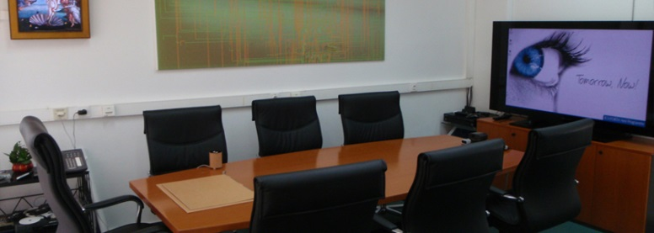
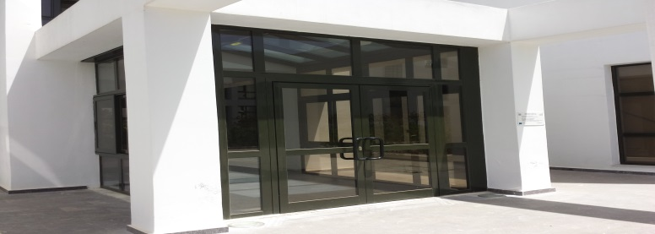
Overview of speaker identification
Goal estimate speaker identity
?
Possible applications
  Information retrieval from speech databases
  Control of financial transactions
  Speaker diarization for meetings
  Speaker-centric ambient intelligence environments
Focus on current work
  Text-independent
  Short training and testing speech data
  Highly noisy environments
Whose is this voice?

Slide 5

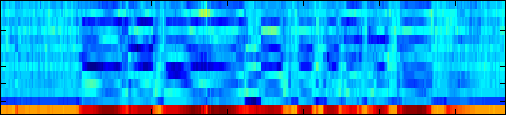


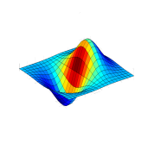


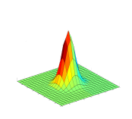


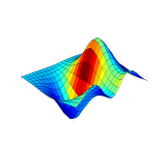
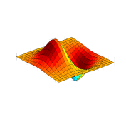


Overview of speaker identification
Model for each
Speaker
Feature Extraction
Build Speaker Models
Enrollment Phase
?
Feature Extraction
Comparison with Speaker Models
Pattern-Matching Classification
Most Likely
Speaker Model
Identification Phase
Identified Speaker

Slide 6
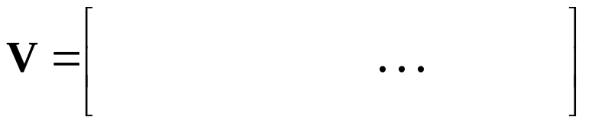







SRC for speaker identification
Sparsity assumption
test instance represented as a sparse linear combination of a
set of training instances (dictionary)
Assume S speakers in the speech corpus
n_{i} training instances (or feature vectors) i^{th} speaker
  Total number of training feature vectors N = n₁ + n₂ +…+ n_{S}
  Training data matrix V

Slide 7
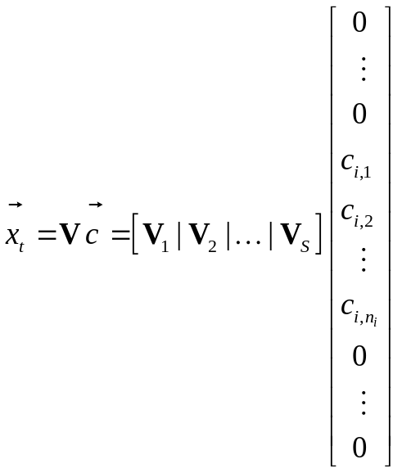


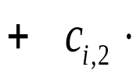
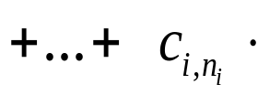




SRC for speaker identification
Sparsity assumption
test instance represented as a sparse linear combination of a
set of training instances (dictionary)
Assume S speakers in the speech corpus
n_{i} training samples (or feature vectors) i^{th} speaker
  Total number of training feature vectors N_{tr} = n₁ + n₂ +…+ n_{S}
  Training data matrix V
  Assume test feature vector
belongs to
the i^{th} speaker
speaker i
sparse code

Slide 8


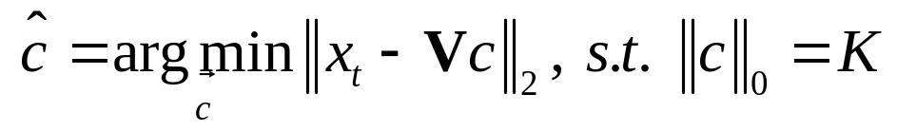
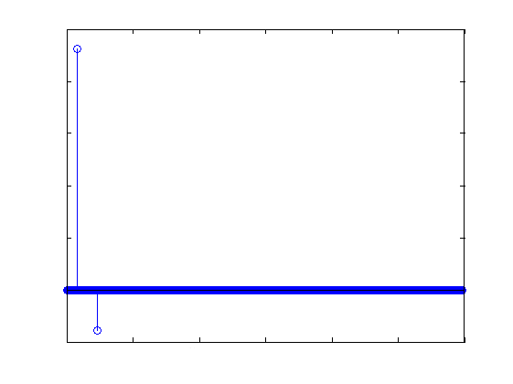
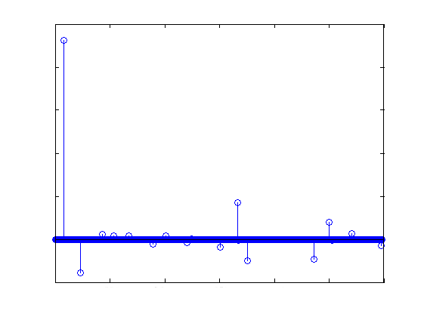
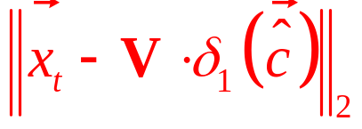
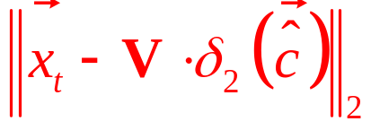
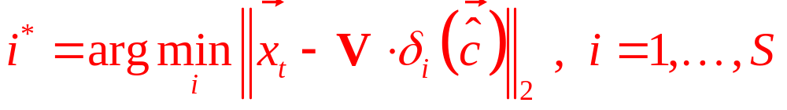



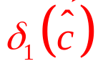
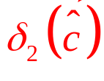
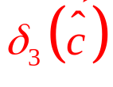
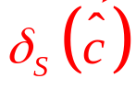
SRC for speaker identification
Given V and estimate sparse code by solving optimization problem
Ideal case e.g. 1st speaker is identified
noise/modeling
errors

Slide 9
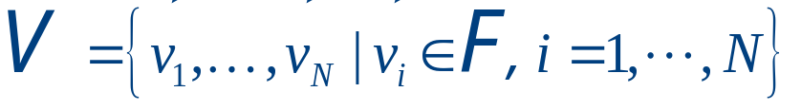

Statistical modeling using KL divergence
Speaker identification multiple hypothesis problem
Assume S speakers
  Set of N independent feature vectors
  Each speaker assigned hypothesis H_{i}
  Select hypothesis best describing test speaker’s data
feature space
Optimal rule
Minimum probability of classification error
Select hypothesis with the highest likelihood

Slide 10
Statistical modeling using KL divergence
Identification process
  Model parameter estimation
  Compute Kullback-Leibler divergence (KLD)
  Assign speaker identity to the smallest KLD value

Slide 11
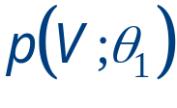
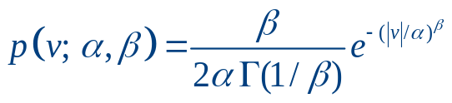
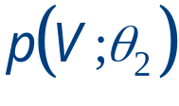
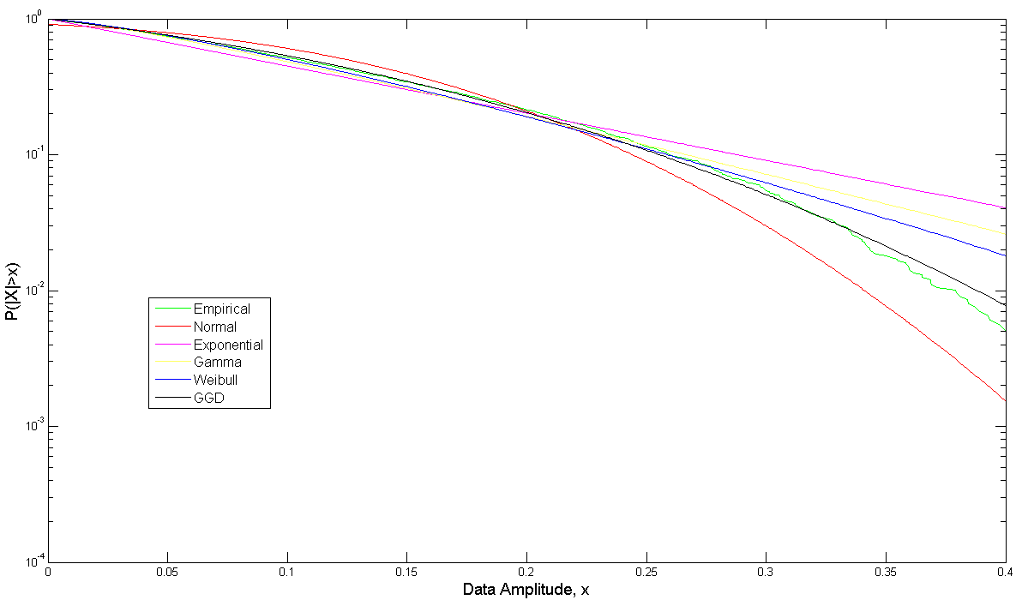

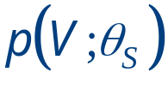
Statistical modeling using KL divergence
Identification process
  Model parameter estimation
  Compute Kullback-Leibler divergence (KLD)
  Assign speaker identity to the smallest KLD value
Generalized Gaussian Density

Slide 12
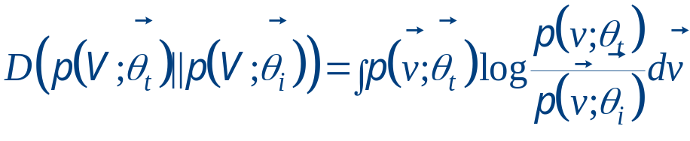
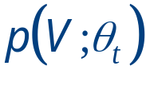
Statistical modeling using KL divergence
Identification process
  Model parameter estimation
  Compute Kullback-Leibler divergence (KLD)
  Assign speaker identity to the smallest KLD value
Kullback-Leibler divergence
KLD
?
KLD
KLD

Slide 13
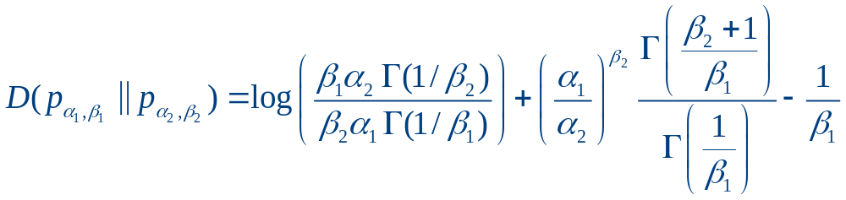
Statistical modeling using KL divergence
Identification process
  Model parameter estimation
  Compute Kullback-Leibler divergence (KLD)
  Assign speaker identity to the smallest KLD value
Chain rule combine KLDs from multiple datasets or dataset dimensions
KLD between two GGds

Slide 14
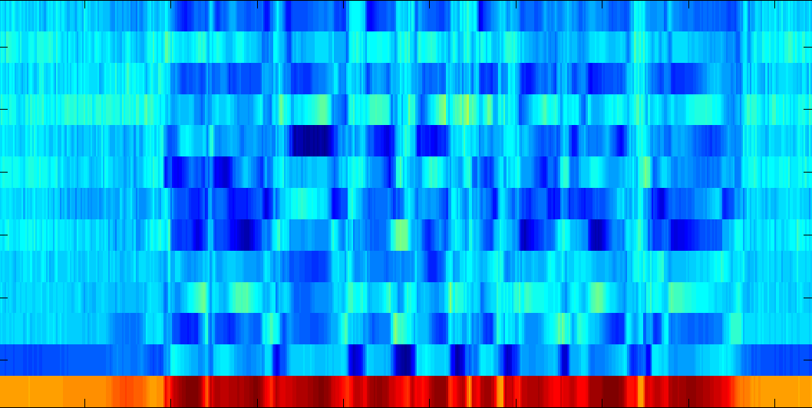
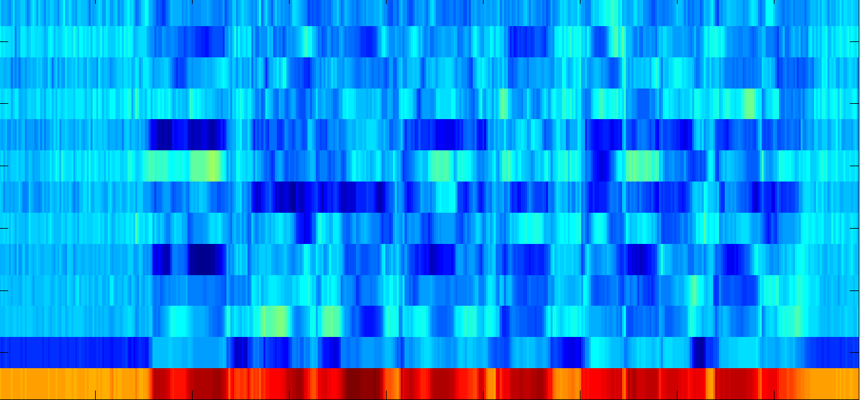


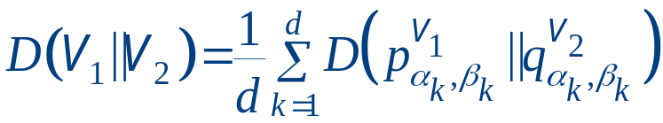
Statistical modeling using KL divergence
Identification process
  Model parameter estimation
  Compute Kullback-Leibler divergence (KLD)
  Assign speaker identity to the smallest KLD value
KLD
KLD
KLD
Mean KLD

Slide 15
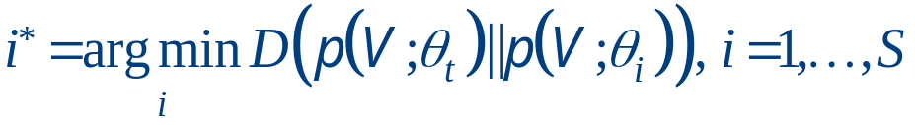
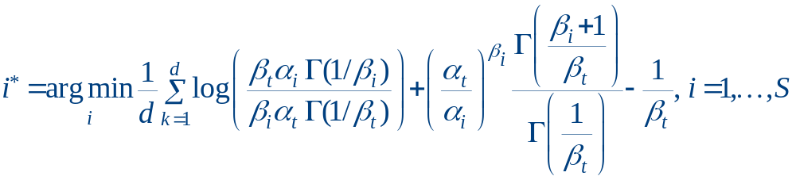
Statistical modeling using KL divergence
Identification process
  Model parameter estimation
  Compute Kullback-Leibler divergence (KLD)
  Assign speaker identity to the smallest KLD value
Chain rule

Slide 16


Experimental results – Part I.a
Compared methods
  SRC
  Gaussian mixture model (GMM)
  GGD-based modeling using KLD (KLD GGD)
Speech corpus
  VOICES 12 speakers
  Original Fs @ 22kHz downsampling @ 8kHz
Feature extraction
  Analysis window 20 msec
  Overlapping 50%
  Mel-frequency spectrogram bands
  Remove silent parts
  Pre-filtering

Slide 17
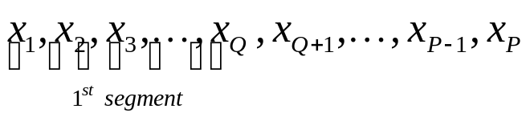
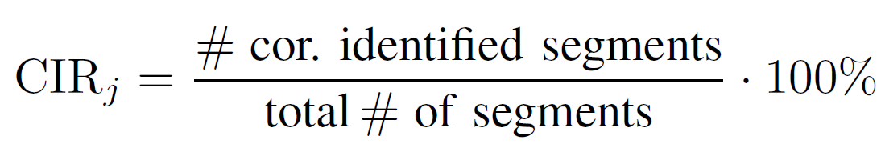
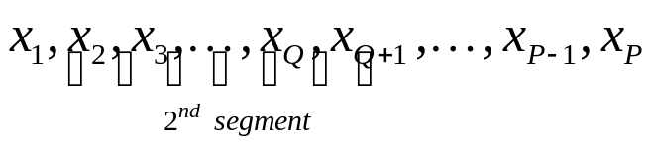
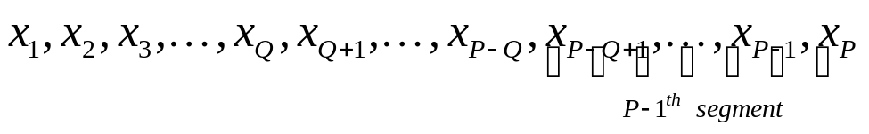
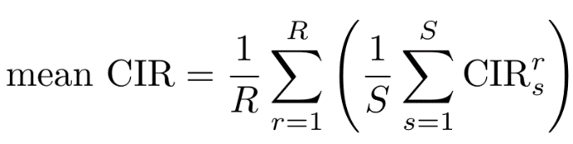
Experimental results – Part I.a
Performance evaluation
Training data (clean speech) 5, 10, 15, 20 sec per speaker
Testing data segment length 10:40:500
  e.g. Q=10→ 0.1 sec, Q=50→ 0.5 sec…
  Add white noise during testing @ 10, 15, 20, 25 dB
Correct identification rate (CIR) of the
j-th speaker
Total mean correct identification rate

Slide 18
Experimental results – Part I.a
Training data (clean speech) 5, 10, 15, 20 sec per speaker
Testing data segment length 10:40:500
  e.g. Q=10→ 0.1 sec, Q=50→ 0.5 sec…
  Add white noise during testing @ 10, 15, 20, 25 dB
GMM
  4 mixtures 5 & 10 sec training data
  8 mixtures 15 & 20 sec training data
  Diagonal covariance matrix

Slide 19
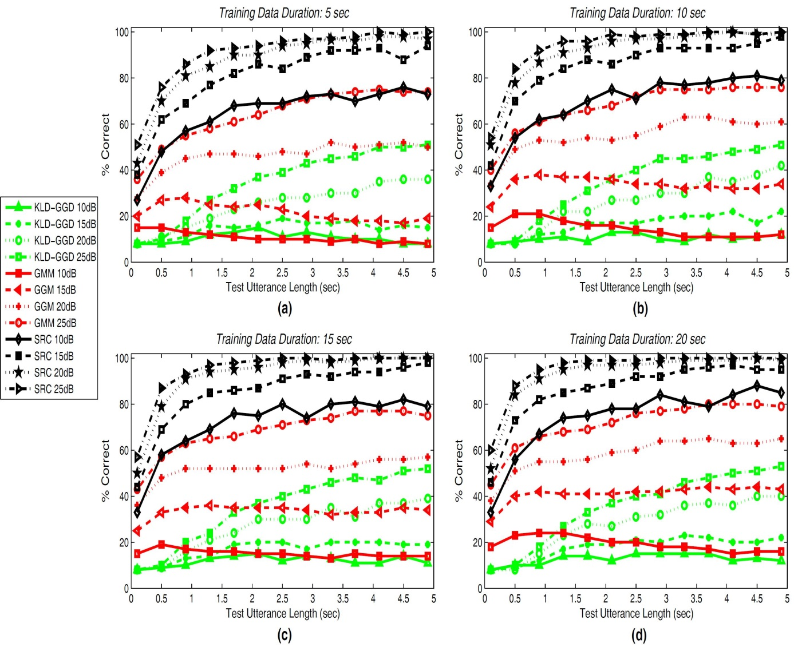
Experimental results – Part I.a
Correct identification rates (%)
GMM and KLD-GGD sensitive to short training/testing data
SRC correct rates >= 80% for 15, 20, 25 dB SNR & 2 sec test data
SRC correct rates >= 70% for all SNR values & 20 sec training data, 1.5 sec test data

Slide 20

Experimental results – Part I.b
Compared methods
  SRC
  Gaussian mixture model (UBM-GMM)
  Joint factor analysis (JFA)
Speech corpus
  VOICES 12 speakers
  Original Fs @ 22kHz downsampling @ 16kHz
Feature extraction
  Analysis window 40 msec
  Overlapping 50%
  Mel-frequency spectrogram bands
  Global cepstral mean and variance normalization
  Feature warping

Slide 21
Experimental results – Part I.b
Training data 12.02 sec per speaker
Testing data 8.02 sec per speaker
  Add noise during testing @ -8, -4, 0, 4, 8, 12 dB
    Speech babble
    Car engine
    Factory floor
    F-16 cockpit
SRC
  Sparsity threshold K=10
UBM-GMM
  Diagonal covariance matrix
  16 Gaussian mixtures
JFA
  Dimension of total variability space 12
  Dimension of i-vectors 11
NOISEX database

Slide 22
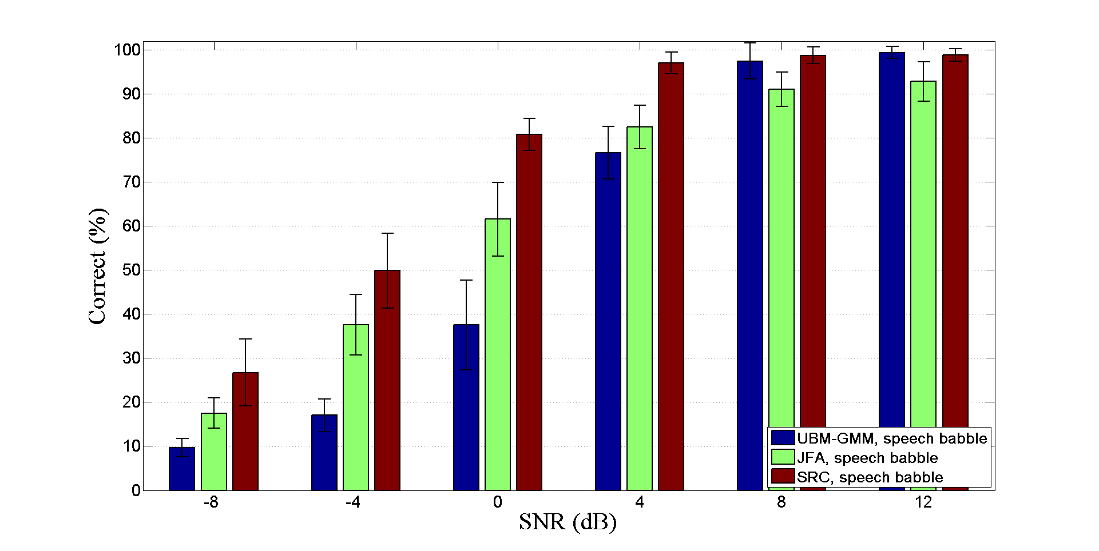
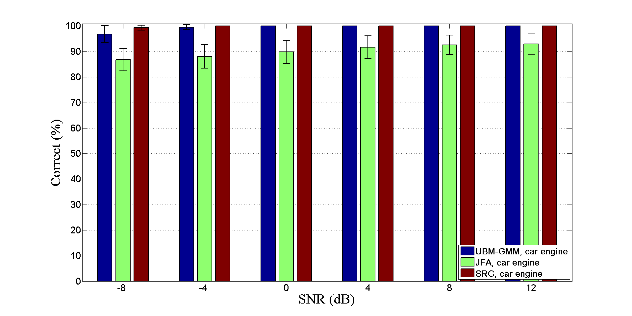
Experimental results – Part I.b
Correct identification rates (%)
speech babble
car engine
SNR (dB) | UBM-GMM | JFA | SRC
12 | 99.40 | 92.83 | 98.84
8 | 97.41 | 91.06 | 98.72
4 | 76.63 | 82.41 | 97.00
0 | 37.55 | 61.56 | 80.78
-4 | 17.02 | 37.55 | 49.84
-8 | 9.70 | 17.51 | 26.72
Average | 56.28 | 63.82 | 75.32
SNR (dB) | UBM-GMM | JFA | SRC
12 | 100 | 92.99 | 100
8 | 100 | 92.61 | 100
4 | 100 | 91.72 | 100
0 | 100 | 89.85 | 100
-4 | 99.56 | 88.05 | 100
-8 | 96.80 | 86.78 | 99.36
average | 99.39 | 90.33 | 99.89

Slide 23
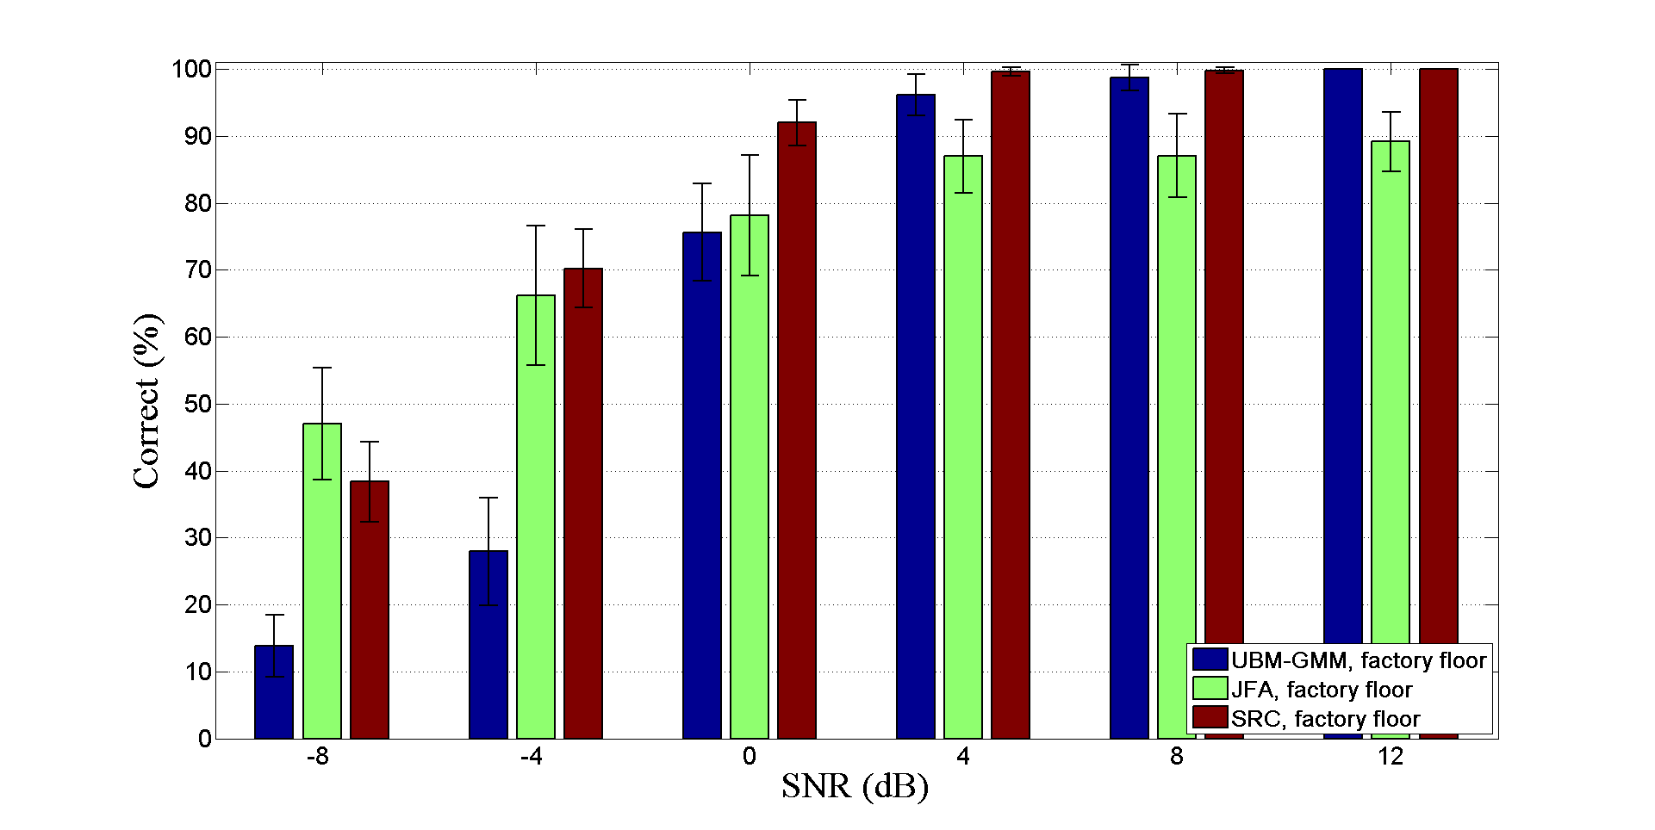
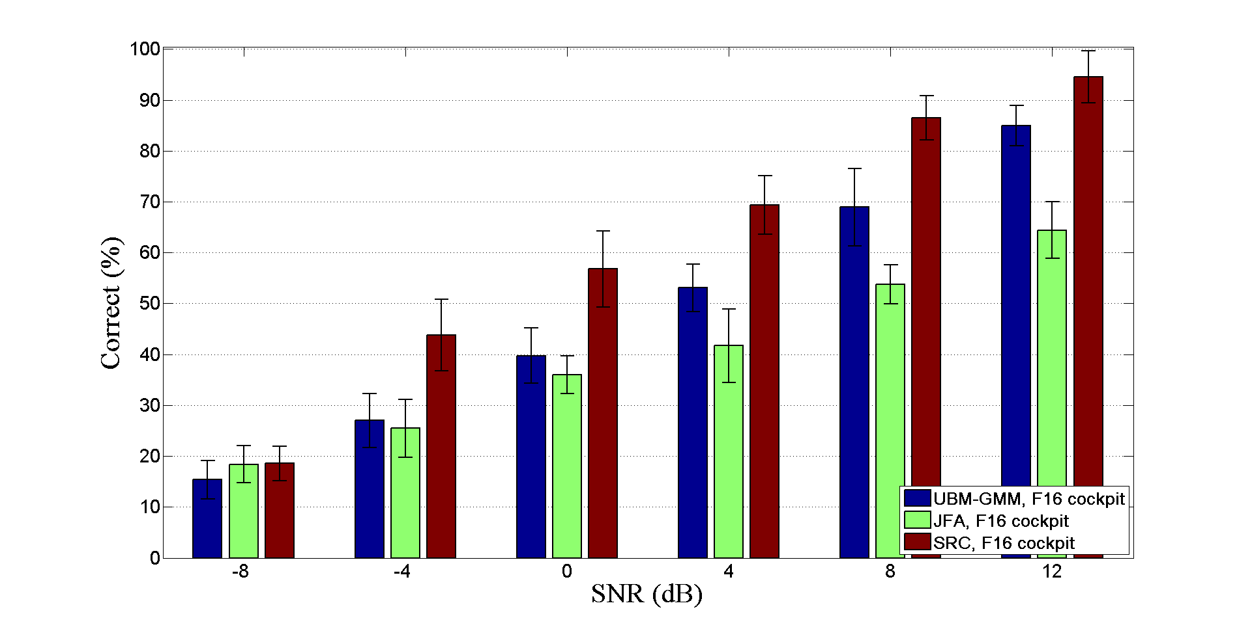
Experimental results – Part I.b
Correct identification rates (%)
factory floor
F-16 cockpit
SNR (dB) | UBM-GMM | JFA | SRC
12 | 100 | 89.14 | 100
8 | 98.67 | 87.07 | 99.80
4 | 96.18 | 86.96 | 99.62
0 | 75.60 | 78.09 | 91.96
-4 | 27.91 | 66.18 | 70.21
-8 | 13.83 | 47.06 | 38.33
Average | 68.70 | 75.75 | 83.32
SNR (dB) | UBM-GMM | JFA | SRC
12 | 84.92 | 64.43 | 94.60
8 | 68.92 | 53.79 | 86.53
4 | 53.08 | 41.68 | 69.41
0 | 39.76 | 36.02 | 56.77
-4 | 27.00 | 25.45 | 43.81
-8 | 15.37 | 18.40 | 18.59
average | 48.17 | 39.96 | 61.62

Slide 24
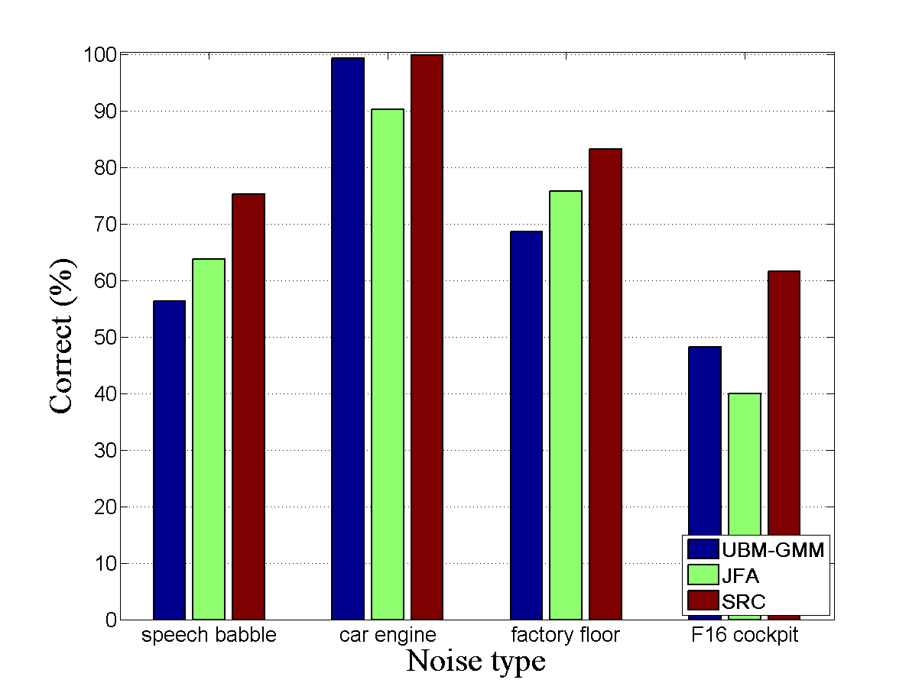
Experimental results – Part I.b
Average correct identification rates (%)
SRC better for all noise types
  Correct rates >= 76% for speech babble, car engine & factory floor
JFA better vs. UBM-GMM
  Speech babble (~8%) & factory floor (~7%)
UBM-GMM vs. JFA
  Car engine (~8.9%) & F16 cockpit (~8.2%)

Slide 25

Discriminative dictionary sparse coding
All the training samples form the dictionary V
  Large & inefficient dictionary due to noisy training instances
  Cost high complexity sparse solver
Careless choice of dictionary elements
  Don’t ensure spanning subspace reasonably well
Problems arising in SRC
Learn a dictionary with discriminative and representational power

Slide 26
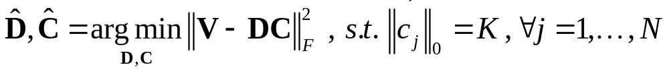
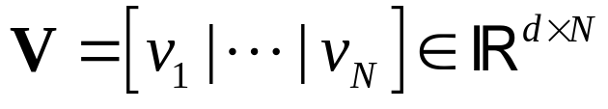
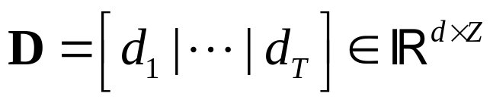
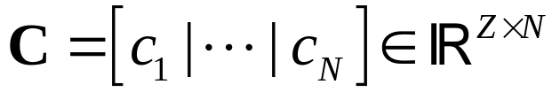
Discriminative dictionary sparse coding
Learn a reconstructive dictionary
training samples
dictionary
sparse codes
dictionary size
learn dictionary
and sparse codes

Slide 27














Discriminative dictionary sparse coding
Enhance discriminability of sparse codes
  Enforce features from the same speaker to have similar sparse representation
    Discriminative sparse codes of
    training features V
Find a transformation forcing instances from the same speaker to have similar sparse representation
class 1
class 2
class 3

Slide 28



Discriminative dictionary sparse coding
Enhance discriminability of sparse codes
  Enforce features from the same class to have similar sparse representation
    Discriminative sparse codes of
    training features V
transforms the original sparse codes in order to enhance discriminative power
class 1
class 2
class 3
reconstruction error
discriminative sparse-code error

Slide 29

Discriminative dictionary sparse coding
Sparse codes inputs to a linear classifier
Goal reduce classification error
e.g. S=3 speakers and
N=5 training samples
speaker1
speaker 2
speaker 3

Slide 30



Discriminative dictionary sparse coding
Sparse codes inputs to a linear classifier
Goal reduce classification error
classifier
parameters
consider classification error

Slide 31




Discriminative dictionary sparse coding
Given test instance
  Compute sparse representation using the estimated dictionary
  Find speaker identity using the estimated classifier parameters
How to estimate speaker identity??

Slide 32

Experimental results – Part I.c
Compared methods
  SRC
  Discriminative dictionary sparse coding
  Gaussian mixture model (UBM-GMM)
Speech corpus
  VOICES 12 speakers
  Original Fs @ 22kHz downsampling @ 8kHz
Feature extraction
  Analysis window 40 msec
  Overlapping 50%
  Mel-frequency spectrogram bands

Slide 33
Experimental results – Part I.c
Training data 10 sec per speaker
  Multicondition training
  Before multicondition (clean data only) T=5988
  After multicondition T=23952
Testing data 15.6 sec per speaker
clean training data
add white noise
10 dB
15 dB
20 dB

Slide 34
Experimental results – Part I.c
Testing data 15.6 sec per speaker
  Add noise during testing @ 0, 5, 10, 15, 20 dB
    White, Speech babble, Car engine, Factory floor
SRC
  Sparsity threshold K=10
Discriminative dictionary sparse coding
  Sparsity threshold K=25
  Regularization parameters λ₁=0.25 & λ₂=2.25
UBM-GMM
  Diagonal covariance matrix
  64 Gaussian mixtures
NOISEX database

Slide 35
Experimental results – Part I.c
Correct identification rates (%)
white
speech babble
SNR (dB) | K-SVD 25 | K-SVD 50 | SRC | UBM-GMM
20 | 89.11 | 96.32 | 92.89 | 97.41
15 | 86.24 | 97.43 | 87.15 | 98.42
10 | 82.92 | 86.77 | 83.45 | 96.41
5 | 74.75 | 71.96 | 58.71 | 47.70
0 | 57.04 | 51.57 | 31.50 | 34.67
average | 78.01 | 80.81 | 70.74 | 74.92
SNR (dB) | K-SVD 25 | K-SVD 50 | SRC | UBM-GMM
20 | 83.95 | 80.41 | 89.88 | 73.90
15 | 88.05 | 81.18 | 86.28 | 55.99
10 | 80.23 | 83.25 | 70.06 | 30.76
5 | 65.33 | 71.62 | 20.76 | 15.16
0 | 46.43 | 47.55 | 9.46 | 13.77
average | 72.79 | 72.80 | 55.28 | 37.91

Slide 36
Experimental results – Part I.c
Correct identification rates (%)
car engine
factory floor
SNR (dB) | K-SVD 25 | K-SVD 50 | SRC | UBM-GMM
20 | 85.52 | 86.45 | 83.29 | 61.55
15 | 76.69 | 82.12 | 69.32 | 49.53
10 | 50.92 | 64.84 | 65.74 | 34.75
5 | 24.75 | 42.55 | 33.82 | 26.80
0 | 13.55 | 27.65 | 17.36 | 17.85
average | 50.28 | 60.72 | 53.90 | 38.09
SNR (dB) | K-SVD 25 | K-SVD 50 | SRC | UBM-GMM
20 | 84.10 | 80.39 | 84.84 | 66.09
15 | 78.32 | 79.92 | 73.16 | 49.39
10 | 73.10 | 75.64 | 63.92 | 11.69
5 | 45.83 | 59.41 | 16.87 | 8.34
0 | 18.12 | 44.18 | 8.33 | 8.33
average | 59.89 | 67.90 | 49.42 | 28.76

Slide 37
Experimental results – Part I.c
Average correct identification rates (%)
SRC at least 15% better vs. UBM-GMM for 3 noise types
KSVD better vs. SRC & UBM-GMM
  KSVD-25 correct rates >= 60% for 3 noise types
  KSVD-50 correct rates >= 70% for 3 noise types
KSVD-25 rates are similar to KSVD-50
  Good results using small-size dictionary important in real-time applications

Slide 38
Contributions & comments
Examine the problem of speaker identification under noisy environmental conditions using short training & testing sessions
  Introduce sparsity-based classification as an alternative to typical UBM-GMM and JFA tools
  Promote discriminative capability of sparse codes by adopting discriminative dictionary learning
    Introduce distance metric learning constraints to further “push” the sparse codes belong to the same speaker to have very small distances
    Use non-linear classifier for a more robust identification performance
Exploit a-priori knowledge about the statistical behavior of speech features KL divergence-based statistical approach seems promising
  Further study in combination with supervised dictionary learning

Slide 39
Part II
Low-rank techniques for recovery of missing features

Slide 40





Overview of missing features recovery
Speech under noisy conditions
  Difficult to achieve high recognition rates (ASR, speaker identification/verification, etc.)
Estimate reliable features
Recognition system
Low accuracy
Increased accuracy

Slide 41
Overview of missing features recovery
Noisy speech decomposed into
  Speech-dominated components reliable
  Noise-dominated components unreliable or missing
Remove unreliable components
  Noisy spectrotemporal data
Recover missing data adopting imputation approach
  Produce reliable estimates of the missing spectrographic regions
Reliability mask distinguishes reliable from unreliable (missing) data
A lot of works dealing with practical reliability mask estimation
Missing data regions
Focus missing data imputation

Slide 42


Overview of missing features recovery
Missing data imputation
Mask estimation
Missing data
imputation
Recovered
data
Mel
filtering

Slide 43










Overview of missing features recovery
Reliability mask estimation
  Apply oracle binary mask
Oracle binary mask estimation
observed spectrotemporal speech data , where
and
  FFT size
  number of time frames
log-magnitude STFT of the noisy speech signal
log-magnitude STFT of the clean speech signal
log-magnitude STFT of the contaminating noise
SNR threshold

Slide 44

Low-rank missing data imputation
YES! … this is what matrix completion (MC) does
Core concept: exploit low-rank behavior of speech features
Speech spectrographic representation satisfies low-rankness?
Could we complete missing data?
SVD

Slide 45






Low-rank missing data imputation
YES! … this is what matrix completion (MC) does
Core concept: exploit low-rank behavior of speech features
Observed entries of data matrix
Known entries
Could we complete missing data?
Assumptions
  Solve convex opt. problem

Slide 46











Low-rank missing data imputation
Define linear map sampling operator recording a specific number of matrix entries ( )
  Use linear map to represent the constraints as
contains the sample values extracted from
Adjoint operator with
  Maps a vector into a sparse matrix
Solve using singular value thresholding (SVT)

Slide 47








Low-rank missing data imputation
Solve using singular value thresholding (SVT)
Iterative process leads to solution
Soft-thresholding operator
  Singular values
Step size

Slide 48





Low-rank missing data imputation
Recover the missing spectrotemporal data
Missing-feature recovery using low-rank matrix completion
Compute mel- spectrogram
mel-spaced filterbank amplitudes
discrete cosine transform (DCT)
Compute MFCCs

Slide 49
Experimental results – Part II.a
Examine the efficiency of SVT in data recovery
  Apply in robust speaker identification
Compare with
  Low-rank matrix fitting (LMaFit)
  Scaled gradients on Grassmann manifolds (ScGrassMC)
Speech corpus
  VOICES 12 speakers
  Original Fs @ 22kHz downsampling @ 16kHz
Feature extraction
  Analysis window 40 msec (50% overlapping)
  30th order mel-frequency spectrogram

Slide 50


Experimental results – Part II.a
Classification method UBM-GMM
  16 Gaussian mixtures
  Diagonal covariance matrix
Training data (clean speech) 10 sec per speaker
Testing data segment length 400 (~8 sec)
  Add noise during testing @ -15, -10, -5, 0, 5, 10 dB
    Speech babble
    Factory floor
NOISEX database
Correct identification rate (CIR) of the
j-th speaker
Total mean correct identification rate

Slide 51



Experimental results – Part II.a
Correct identification rates (%)
speech babble
factory floor
numbers inside parentheses
SVT performs better
  Both noise types SNR @ -10 dB (~80% missing data) mean CIR ~80%
  Both noise types SNR >= -5 dB mean CIR >= ~87%

Slide 52
Experimental results – Part II.a
Examine the efficiency of low-rank matrix recovery vs. sparse imputation
  Sparse imputation (SI) based on sparsity assumptions
  Supervised dictionary-based approach
Add noise during testing @ -16, -12, -8, -4, 0, 4, 8, 12 dB
  Speech babble
  Factory floor
NOISEX database

Slide 53


Experimental results – Part II.a
Correct identification rates (%)
speech babble
factory floor
SVT better vs. SI
  Both noise types @ SNR <= -4 dB
SVT 30% better vs. SI
  Speech babble noise @ SNR = -16 dB
SVT 15% better vs. SI
  Speech babble noise @ SNR = -12 dB
SVT 10% better vs. SI
  Factory floor noise @ SNR = -16 dB

Slide 54

















Joint low-rank representation and MC
Low-rank matrix completion (MC) unsupervised approach
  Exploit a-priori knowledge of training data per speaker
  supervised MC algorithm
Typical low-rank MC …any information about the procedure generated the data matrix ?
NO! … introduce low-rank representation (LRR)
  Exploit the supervised nature of the speaker identification task
    Training data obtained from each speaker
Speaker 1
Speaker 2
Speaker 3
=
=
=

Slide 55





Joint low-rank representation and MC
Speaker 1
Speaker 2
Speaker 3
=
=
=
=
Block diagonal matrix L is the lowest
rank representation of the test data M
with respect to training data G

Slide 56





Joint low-rank representation and MC
Apply LRR on matrices with missing data
  Combine MC and LRR seeks a low-rank coefficient matrix from a small number of measurements
Low-rank matrix
Observed data matrix
Dictionary

Slide 57




Joint low-rank representation and MC
Apply LRR on matrices with missing data
  Combine MC and LRR seeks a low-rank coefficient matrix from a small number of measurements
Large-scale problems:
solve using singular value thresholding (SVT)
J-SVT

Slide 58


Joint low-rank representation and MC
Apply LRR on matrices with missing data
  Combine MC and LRR seeks a low-rank coefficient matrix from a small number of measurements
Nesterov accelerated version

Slide 59







Experimental results – Part II.b
Examine the reconstruction performance of J-SVT vs. SVT
  Simulations on synthetic data
    Dictionary
    Low-rank representation matrix
Evaluation metric
Normally distributed
random samples
Experimental parameters
maximum number of iterations
tolerance
optimization parameter
step size
  SVT 1.9
  J-SVT

Slide 60

Experimental results – Part II.b
J-SVT reconstruction performance for a varying matrix rank
  Fixed dictionary size 300 × 1500
Fig.(a): J-SVT almost zero for Sampl. Ratio (SR)>0.3 while SVT almost zero for SR>0.7
Fig.(b)-(d): J-SVT close to zero for SR≈0.7 while SVT approaches zero only for an almost full sampling (SR≈0.9)

Slide 61

Experimental results – Part II.b
J-SVT reconstruction performance for a varying dictionary size
  Fixed rank(L) 50
J-SVT achieves superior performance against SVT in all cases
J-SVT almost constant behavior regardless of the dictionary size
  Advantage in practical scenarios, where the dictionary size comes at the expense of increased computational memory complexity

Slide 62

Experimental results – Part II.b
Robustness of J-SVT vs. SVT under noisy conditions
  Fixed dictionary size 300 × 1500
  Fixed rank(L) 50
Fig.(b)-(d): SVT relative error is almost twice as high vs. J-SVT for the same range of SR

Slide 63
Contributions & comments
Enhance the reliability of noisy speech features for robust speaker identification
  Adopt missing data imputation framework
Exploit low-rankness of spectrographic speech data
  Apply low-rank matrix completion to recover missing data regions
Introduce a supervised version of matrix completion
  Joint low-rank representation and matrix completion
  Propose J-SVT algorithm to find the low-rank representation of a partially observed matrix especially targeted for missing data imputation
    Simulations using practical reliability masks
    Use J-SVT to produce reliable speech features and feed as input to other recognition systems e.g. ASR

Slide 64
List of publications during PhD study
C. Tzagkarakis, S. Becker and A. Mouchtaris, “Missing Data Imputation Based on Joint Low-Rank Representation and Matrix Completion”, journal paper under preparation.
C. Tzagkarakis, S. Becker and A. Mouchtaris, “Joint Low-Rank Representation and Matrix Completion Under a Singular Value Thresholding Framework”, in Proc. of European Signal Processing Conference (EUSIPCO '14), Lisbon, Portugal, September 2014.
C. Tzagkarakis and A. Mouchtaris, “Reconstruction of Missing Features Based on a Low-Rank Assumption for Robust Speaker Identification”, invited paper in Proc. of International Conference on Information, Intelligence, Systems and Applications (IISA '14), Chania, Greece, July 2014.
C. Tzagkarakis and A. Mouchtaris, “Sparsity Based Noise Robust Speaker Identification Using a Discriminative Dictionary Learning Approach”, in Proc. of European Signal Processing Conference (EUSIPCO '13), Marrakech, Morocco, September 9-13, 2013.
C. Tzagkarakis and A. Mouchtaris, “Robust Speaker Identification Using Matrix Completion Under a Missing Data Imputation Framework”, in Proc. 2013 Workshop on Signal Processing with Adaptive Sparse Structured Representations (SPARS '13), Lausanne, Switzerland, July 8-11, 2013.
A. Griffin, T. Hirvonen, C. Tzagkarakis, A. Mouchtaris and P. Tsakalides, “Single-channel and Multichannel Sinusoidal Audio Coding Using Compressed Sensing”, IEEE Transactions on Audio, Speech and Language Processing, Vol. 19 (5), pp. 1382-1395, July 2011.
C. Tzagkarakis and A. Mouchtaris, “Robust Text-Independent Speaker Identification Using Short Test and Training Sessions”, in Proc. of European Signal Processing Conference (EUSIPCO '10), Aalborg, Denmark, August 2010.
C. Tzagkarakis, A. Mouchtaris and P. Tsakalides, “A Multichannel Sinusoidal Model Applied to Spot Microphone Signals for Immersive Audio”, IEEE Transactions on Audio, Speech and Language Processing, Vol. 17 (8), pp. 1483-1497, November 2009.
A. Griffin, C. Tzagkarakis, T. Hirvonen, A. Mouchtaris and P. Tsakalides, “Exploiting the Sparsity of the Sinusoidal Model Using Compressed Sensing for Audio Coding”, in Proc. Workshop on Signal Processing with Adaptive Sparse Structured Representations (SPARS '09), Saint-Malo, France, April 6-9, 2009.

Slide 65

Thank You
Questions!

